Slide 1
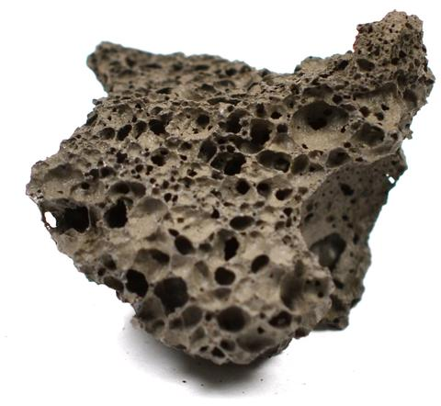
Daily Review
Rocks can be identified using their physical properties. The properties geologist use are: colour, layers, grains or crystals and holes.
On your whiteboard, use those 4 properties to describe this rock.

Slide 2
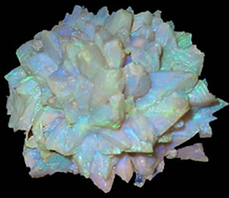
Daily Review
Minerals can be identified using their physical properties.
One physical property geologists look at is the lustre (shininess) of the mineral. A mineral can be classed as metallic, pearly, glassy or dull.
Think, Pair, Share: What is the lustre of this mineral?

Slide 3
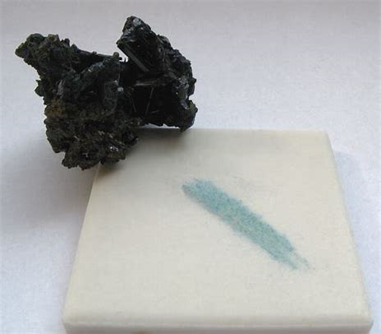
Daily Review
Minerals can be identified using their physical properties.
Another physical property geologists look at is the streak, which is the colour of the crushed mineral.
On your whiteboard, write the external colour of this mineral and its streak colour.

Slide 4
The Structure of the Earth Year 8 Science

Slide 5
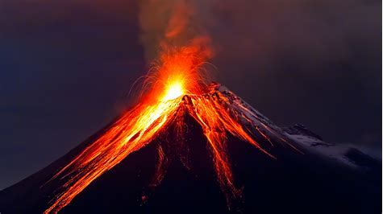
Learning Objective
CFU
What are we going to learn?
Identify the layers of the Earth
Describe the composition of each layer
Activate Prior Knowledge
Think, Pair, Share: What comes out of volcanoes? Where does it come from?

Slide 6
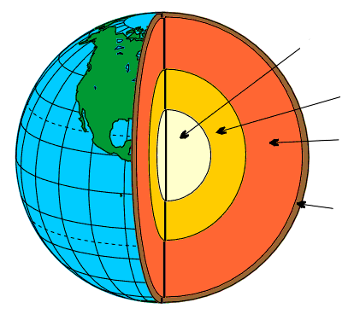
Concept Development
CFU 1
What is a property?
Earth’s Structure
The Earth has four main layers.
Each layer has different properties.
The four layers are:
CFU 2
Which layer is the outermost layer?
CFU 3
Which layer is the innermost layer?
Inner core
CFU 4
Which layer is the thinnest layer?
Outer core
Mantle
Crust
Vocabulary
property characteristic, feature or quality

Slide 7
Concept Development
CFU 1
What is the crust made out of?
Crust
The crust is made of solid rock.
It is between 10 km and 70 km thick.
The average temperature on the surface of the Earth is approximately 25 °C.
CFU 2
How thick is the crust?
Inner core
Outer core
Mantle
Crust
Vocabulary
property characteristic, feature or quality

Slide 8
Concept Development
CFU 1
What is the mantle made out of?
Mantle
The mantle is made of molten rock.
It is approximately 2900 km thick.
Depending on the depth, the temperature is between 1000 – 3500 °C.
CFU 2
How are the crust and the mantle similar?
CFU 3
How are the crust and the mantle different?
Inner core
Outer core
Mantle
Vocabulary
property characteristic, feature or quality molten liquid
Crust

Slide 9
Concept Development
CFU 1
What two metals is the outer core made out of?
Outer Core
The outer core is made of molten iron and nickel.
It is approximately 2900 km thick.
Depending on the depth, the temperature is between 4000 – 6000 °C.
The outer core flows around the centre of the Earth.
This movement creates our planet’s magnetic field.
CFU 2
What is the temperature range in the outer core?
CFU 3
How are the mantle and the outer core similar?
Inner core
CFU 4
How are the mantle and the outer core different?
Outer core
Mantle
Vocabulary
property characteristic, feature or quality molten liquid
Crust

Slide 10
Concept Development
CFU 1
What two metals is the inner core made out of?
Inner Core
The inner core is made of solid iron and nickel.
It is approximately 2500 km in diameter.
Depending on the depth, the temperature is between 5000 – 6000 °C.
The inner core stays solid because of the immense pressure surrounding it.
CFU 2
What is the temperature range in the inner core?
CFU 3
How are the inner and the outer cores similar?
Inner core
CFU 4
How are the inner and the outer cores different?
Outer core
Mantle
Vocabulary
property characteristic, feature or quality molten liquid
Crust

Slide 11
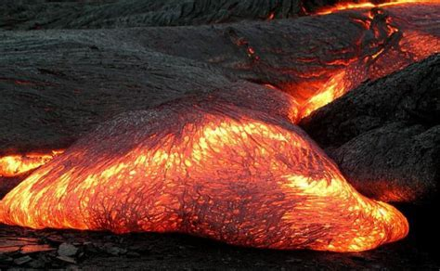
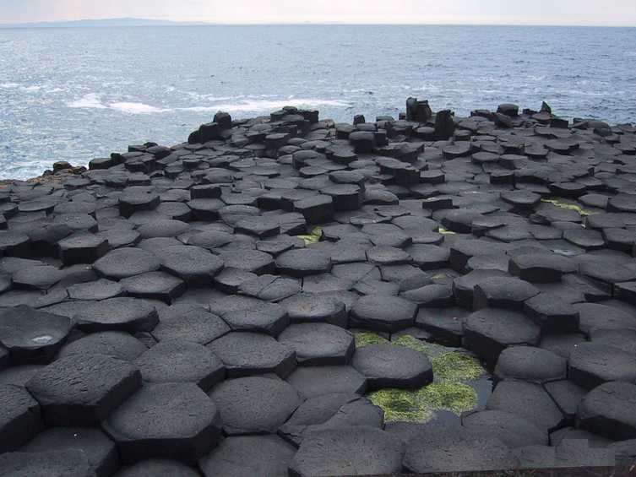
Relevance
Understanding the structure of the Earth will help you understand how different types of rocks are formed.

Slide 12
Skill Closure
Draw and label the layers of the Earth on your whiteboard
(Mantle, Inner core, Crust, Outer core).
Skill Closure
State one way the structure of the crust is similar to the mantle and one way it is different.
Skill Closure
Even though it is the hottest part of the Earth, the inner core is not molten (a liquid). Explain why.

Slide 13
Independent Practice
On the sheet provided, create an annotated scale diagram of the Earth, including information about the composition of each layer, its thickness and its temperature.
You will need to draw in the crust freehand as a thin layer. It is not even in thickness so you could include some mountains, valleys or oceans.
Don’t forget to include a title on your page.
Layer | Composition | Thickness | Temperature
Crust | Solid rock | 10-70 km | Average 25 °C
Mantle | Molten rock | 2900 km | 1000 – 3500 °C
Outer core | Molten iron and nickel | 2900 km | 4000 – 6000 °C
Inner core | Solid iron and nickel | 2500 km (diameter) | 5000 – 6000 °C

